Slide 1


The AI Operating System
for Real Estate
With Gu as the AI coworker that helps real-estate teams understand what’s happening, make better decisions, and get work done.
Humans lead. Gu gets work done.
Notes:
Ungga is building the AI operating system for real-estate companies, with Gu as the AI coworker that understands, coordinates, and gets work done across the brokerage. To understand why an operating system is needed, start with how brokerages generate—and lose—revenue today.

Slide 2
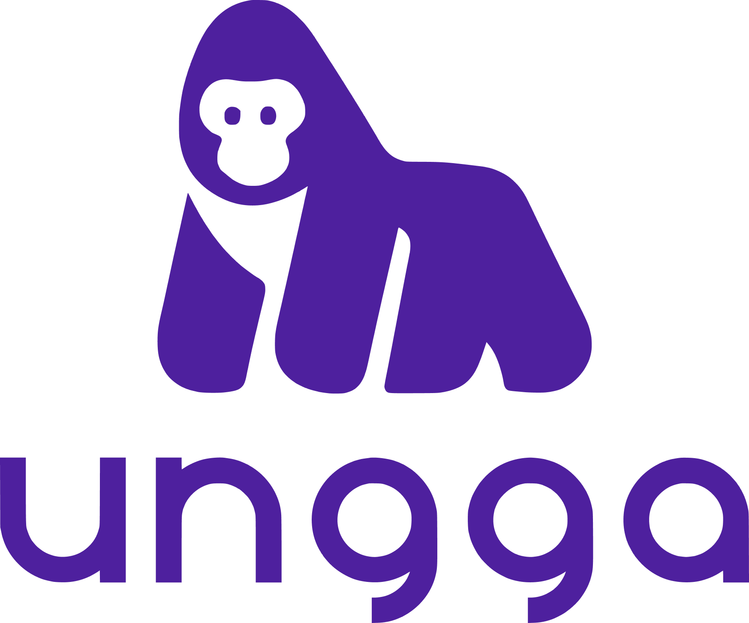
THE PAIN
Brokerages struggle to generate enough qualified opportunities and lose many before they become visits and transactions.
GENERATING DEMAND
CONVERTING DEMAND
Enough qualified opportunities are hard to generate predictably.
Too many opportunities stall before reaching a visit.
Slow response
Demand arrives 24/7. Human attention doesn’t.
Portals
Paid social
Organic
Inconsistent follow-up
Opportunities depend on memory and discipline.
Referrals
Offline
Agencies
Missed matches
The right inventory may sit elsewhere.
Multiple sources → Significant effort → Uncertain downstream results
No-shows
Scheduled does not always mean attended.
Stalled opportunities
Momentum decays without a next action.
BUSINESS IMPACT:
·
Wasted acquisition effort
·
Constrained growth
·
Team overload
·
Lost commissions (revenue)
Notes:
For many brokerages, the problem starts before a lead exists: enough qualified demand is difficult to generate consistently across portals, paid social, organic, referrals, agencies and offline channels. Once opportunities arrive, too many still disappear before becoming visits. They can arrive at night, on weekends, or while advisors are busy with visits, negotiations and other work. Brokerages lose on both sides: they struggle to generate enough demand, then leak part of the demand they already worked to create.
---
Note:
Team constantly keeping opportunities moving es más bien operational/human impact.
No es incorrecto tenerlo ahí, pero podríamos afinarlo a algo más económico/compacto, por ejemplo: Operational overload o Team overload

Slide 3
WHY THE PROBLEM PERSISTS
The human is still the operating system.
Software digitized the pieces, but people still have to manually connect demand, conversations, systems and execution.
manual middleware
DEMAND SOURCES
INBOUND
SYSTEMS + EXECUTION
OUTCOMES
Where opportunities begin
Conversations start here
HUMAN
COORDINATION
LAYER
Where work must happen
Where revenue becomes possible
Portals
Paid
WhatsApp
CRM
Inventory
VISITS
Organic
Referrals
Web
Telegram
Calendar
Docs
Respond · Remember · Search
Coordinate · Update · Follow up
TRANSACTIONS
Offline
Agencies
People
Providers
The bottleneck is not the lack of tools — it is the human effort required to keep the operation connected.
● Multiple demand sources
Fragmented inputs create coordination work.
● Work spans systems & people
No single tool contains the full operational reality.
● Execution remains human-dependent
Availability, memory and follow-through still shape outcomes.
CONFIDENTIAL
ungga.com
3
Notes:
Real-estate businesses already have software: CRMs, portals, calendars, messaging tools and specialized providers. But none of those systems owns the whole job. The advisor, coordinator or owner still interprets what is happening, moves information between systems, decides what happens next, and makes sure somebody actually does it. In practice, the human becomes the middleware—and effectively the operating system.

Slide 4
WHY NOW
AI can now participate in the operation—not just assist the user.
The relationship between people and software is changing.
TRADITIONAL SOFTWARE
AI-NATIVE OPERATION
1
Human understands what is happening
Human sets intent / objective
Human decides what to do
AI understands context
2
Reasons and uses tools
3
Human finds the right software
Coordinates multi-step work
4
Human enters data / clicks / coordinates
Humans intervene where judgment or authorization matters
5
Human remembers what must happen next
Outcome is verified
Humans operate the software and connect the workflow.
AI increasingly participates in operating the work.
Reasoning · Tools · Context · Durable State · Governed Execution
Notes:
For decades, software digitized information, but the human still had to understand the situation, decide what to do, open the right system, enter information, and coordinate the next step. Current AI changes that relationship. Models can reason over context, use tools and execute multi-step work; an operating layer can provide durable state, permissions, verification and human decision points. That means software can increasingly participate in the operation itself.

Slide 5

GU TODAY
We started at a critical step toward revenue: moving prospects from inquiry to property visits.
Gu already takes responsibility for meaningful commercial work—not just answering questions
1
2
3
4
5
INQUIRY
UNDERSTAND
MATCH
FOLLOW UP
VISIT
Engage 24/7
Profile intent
Search inventory
Keep momentum
Coordinate & support attendance
Gu — AI coworker
Always available capacity, with customer-controlled automation.
[XX leads handled]
[XX% actual attended-visit rate]
24/7 capable
Customer-controlled
Shared inventory + integrated real-estate services extend Gu’s reach beyond a brokerage’s own resources.
Notes:
We started with one concrete workflow close to revenue. A new prospect arrives and Gu can engage them, understand what they are looking for, search and match inventory, follow up through configured policies and move the opportunity toward a property visit, and move the opportunity toward a property visit. Demand is asynchronous. Prospects do not wait until an advisor is free; Gu adds capacity where human availability becomes a bottleneck. Gu can operate 24/7, but the brokerage decides when automatic responses are active and can pause them when needed.

Slide 6
FROM GU TO GU OS
Real work needs more than conversation.
When an AI worker participates in durable business work, conversation can no longer be its only operational state or source of truth.
STATE
What is happening?
What already happened?
GU OS
The durable operating environment behind Gu
Operational state
Durable work
PROGRESS
What must happen next?
What is blocked or dependent?
what is actually happening
cases, workflows, waits and dependencies
Skills & tools
Rules & permissions
GOVERNANCE
What rules apply?
What is authorized?
Who must decide?
what Gu knows how to do and the systems it can act through
what Gu is allowed to do
Human decision points
Evidence & verification
VERIFICATION
How do we know it is complete?
What changes if a fact changes?
where people lead, approve or intervene
how completion and changed facts are handled
Conversation alone cannot reliably govern all of this.
Gu is who you work with.
Gu OS is what makes increasingly complex work possible.
Technical foundation built · broader production validation underway
Notes:
The more real work customers asked Gu to take on, the more we discovered that conversation alone was not enough. For example, if an owner changes a property price after agreements and commercial material have already been prepared, the system needs to know what changed, which prior work remains valid, and what must be repaired. That is the difference between conversational memory and durable operational state. Doing real work exposed the operating infrastructure Gu needs to take on more responsibility.

Slide 7
PROPERTY OPTIONING
The first durable Gu OS workflow is already operating in the real world.
Property Optioning — from property intake to publication.
GU / AI
TOOL
HUMAN
WAIT / DEPENDENCY
01
02
03
04
05
Register
Documents
Property data
Validate
Comparables
AI
WAIT
AI
HUMAN
TOOL
06
07
08
09
10
Price approval
Legal agreement
Photos
Commercial package
Publish
HUMAN
AI
WAIT
AI
TOOL
A multi-day business procedure can persist across conversations, waits, approvals, external systems and changing facts.
[XX cases started]
[YY completed]
Reusable building blocks: Documents · Comparables · Approvals · Publishing
EARLY / BETA
Notes:
The first procedure used to generalize the architecture is Property Optioning. Capturing a listing is not one AI task: it spans documents, property data, comparables, owner approval, the commission agreement, photos, commercial preparation and publication. Some steps are performed by Gu, others use tools, others need a human decision, and others simply wait for an external dependency. Gu OS keeps the procedure alive across all of that. Property Optioning matters less as a single feature than as evidence that the same operating foundation can represent real multi-day business work.

Slide 8
PRODUCT EXPANSION
From lead conversion to the full brokerage revenue operating loop.
DEMAND
GENERATION
CONVERSION
Understand · match ·
Advance opps (rule-based)
Generate qualified opportunities
EXPANSION
CURRENT
PROPERTY ONBOARDING
Gu OS
Source · capture · validate · price · prepare · publish
Connects the loop
EARLY / BETA
OUTCOME
FEEDBACK
TRANSACTION
What actually happened?
Visit · relationship · negotiate · close
EXPANSION
HUMAN-LED /
GU-ASSISTED
Connect the full revenue loop and feed real-world outcomes back into what happens next.
Notes:
The goal is not dozens of unrelated workflows. The goal is to connect the economic loop of the brokerage. Today Gu participates materially in conversion. Property Optioning begins to extend into property onboarding. Demand generation and deeper outcome feedback are strategic expansion areas. If one campaign produces cheaper leads but very few reach a visit, while another produces more expensive leads but many more visits, the upstream metric can point to the wrong business decision. The opportunity is to connect what generates demand with what happens after the lead arrives.
---
Note:
- Lower Cost Per Lead (CPL) ≠ better downstream outcome
- El loop comunica: What inventory works → which demand sources work → which opportunities convert → what actually happens → what should change next.

Slide 9
COMPOUNDING OPERATING INTELLIGENCE
The more Gu works with a brokerage, the more useful it can become.
Value compounds when raw interactions become operating intelligence: business context, reusable patterns, outcome evidence and ecosystem reach.
BUSINESS CONTEXT
Customers · properties · relationships · decisions · history
NETWORK & ECOSYSTEM
Shared inventory · cross-brokerage opportunities · integrated services
Gu OS
OPERATING PATTERNS
Operating
Intelligence
Skills · workflows · policies · reusable patterns
TRUST & DELEGATION
Reliable work earns permission to participate in more work
OUTCOME EVIDENCE
What Gu did → what actually happened
More work delegated → More context + evidence → Better understanding → Better execution → More trust → More work delegated
Compounding thesis · systematic learning & improvement remains a governed future capability.
Notes:
We assume the underlying models will improve rapidly. The value we want to accumulate is not just conversation history but operating intelligence about this specific company. More work can create richer business context, more reusable operational patterns, more outcome evidence, a broader network of resources, and greater customer trust and delegation. Systematic learning and self-improvement is a governed future capability—not something we claim is broadly live today.

Slide 10
ECONOMIC OPPORTUNITY + BUSINESS MODEL
The economic opportunity extends beyond the software budget.
As Gu takes on real work, it can create value across software, services, organizational capacity and opportunities that would otherwise be lost.
SOFTWARE
OUTSOURCED SERVICES
INTERNAL CAPACITY
OPPORTUNITY PRESERVATION
CRM · point tools · workflow software
Orchestrate external capabilities and selectively build/absorb differentiating ones.
Campaign management · lead operations · coordination
Perform work customers already pay others to do.
More output without proportional operational headcount growth.
After-hours leads · missed follow-up · missed matches · stalled prospects.
PREPAID CREDITS
INITIAL MARKET
Customers consume credits as Gu performs work.
Mexico SMB brokerages
[XX target organizations]
Bottom-up SAM: [$XX]
Work / usage-based pricing through prepaid credits.
Customer spend can grow as more—and more valuable—work is delegated to Gu.
Expansion: larger brokerages · franchises · developers · LatAm
Notes:
Traditional SaaS is constrained largely by the software budget. Because Gu actually performs work, we believe it can participate in a broader economic surface. Value can come from software customers no longer need to operate directly, outsourced services, additional organizational capacity, and opportunities that otherwise would be lost. We are moving from a low fixed SaaS subscription toward prepaid credits consumed as Gu performs work. The metric that matters is not a first load; it is consumption, reload, retention and expansion.
--
Notes:
Economic value influenced ≠ revenue Ungga automatically captures. That is, customer value extends beyond the spend Ungga directly captures.
Reload matters more than first payment.
- Recovered Opportunities puede transmitir la idea equivocadaTienes razón: recovered sugiere que primero se perdió la oportunidad y después Gu la rescató. Eso puede ocurrir con un prospecto estancado, pero una parte importante del valor de Gu consiste precisamente en evitar que se pierda:responder cuando el asesor no está disponible;mantener el seguimiento;encontrar un match que de otra forma se habría omitido; evitar que una oportunidad se enfríe; reducir no-shows, etc. La opción preferida sería: OPPORTUNITY PRESERVATION o PRESERVED & RECOVERED OPPORTUNITIES.
- PREPAID CREDITS
Work / usage-based pricing: customers consume credits as Gu performs work.
Spend can grow as more—and more valuable—work is delegated to Gu.
Esta versión me gusta mucho porque en dos líneas responde exactamente:
¿Cómo pagas? → prepaid credits / work-usage based.
¿Por qué puede crecer el ARPA? → Gu hace más trabajo y trabajo de mayor valor.
Incluso considero que more—and more valuable—work es importante. No queremos transmitir que el único camino a más revenue sea hacer más volumen de la misma tarea. Gu OS permite eventualmente pasar de:
follow-up
a:
property onboarding, demand generation, coordination of services, workflows, etc.
y esos trabajos pueden tener distinta importancia económica.
- La relación estratégica que aquí se muestra en Software es:
Integrate → orchestrate → become the operating environment → selectively absorb functionality.

Slide 11
TRACTION + GTM
Early retention signals are encouraging.
Repeatable growth is the next proof.
WHAT WE KNOW
THE CUSTOMER FACTORY WE ARE PROVING
[XX] current paying brokerages
ACQUIRE
ACTIVATE
FIRST WORK
PAY
CONSUME
RELOAD
RETAIN
EXPAND
[XX] retained >1 year
[XX] retained >2 years
Account created
Gu enabled
Starter credits · card on file
First paid credits loaded
Paid credits used
Repeat purchase
Continued active usage
More work delegated
Commercial proof = repeatable acquisition → paid usage → reload → retention → expansion.
[XX] customers with ≥1 reload
GTM MOTIONS WE ARE TESTING
1
DIRECT ACQUISITION
2
INDUSTRY / CHANNEL DISTRIBUTION
3
LAND & EXPAND
Founder-led selling · WhatsApp outreach · ICP-based outbound · paid digital campaigns
Associations · events · franchise / office relationships · partner-driven introductions
Lead-conversion wedge → reload → broader work delegated to Gu / Gu OS
[XX reached → YY activated → ZZ paid → NN reloaded]
ICP hypothesis: high operational intensity × high economic value per opportunity.
CONFIDENTIAL
ungga.com
11
Notes:
We have encouraging evidence that some customers can retain for a long time, but that is not the same as proving repeatable product-market fit. Our main job now is to prove a customer factory: acquire the right brokerage, activate meaningful work, turn that into consumption, reload, retention and expansion. So, our next proof is turning the technical foundation into a repeatably deployable product and a repeatable commercial engine—while expanding the amount of valuable work customers delegate to Gu.
---
Notes:
- El funnel inferior [XX contacted → YY activated → ZZ paid → NN reloaded] es bueno
Lo conservaría.
Pero cuando tengamos datos, me gustaría que la cohorte sea explícita:
WhatsApp GTM test: XX reached → YY activated → ZZ paid → NN reloaded
o el canal que corresponda.
Porque, de lo contrario, un VC puede preguntarse:
“¿contacted de qué campaña? ¿de toda la historia de la compañía?”
Una cohorte pequeña pero bien definida es más creíble.
- La lamina respondería tres preguntas distintas
Traction
Is anybody staying and paying?
Commercial engine
What behavior proves that this works economically?
GTM
How are you trying to make customer acquisition and expansion repeatable?
- La diferencia clave es:
Reload = el cliente vuelve a comprar créditos después de haber consumido parte o todo lo anterior.
Retain = el cliente permanece activo y continúa usando/pagando durante el tiempo.
Es decir, Reload es un evento de recompra; Retain es una relación sostenida.
Un cliente puede hacer un reload una vez y luego desaparecer: hubo reload, pero no necesariamente buena retención. En cambio, si durante varios meses sigue usando Gu, recargando cuando corresponde y manteniéndose activo, entonces hablamos de retention.
Yo definiría todo el path así:
ACQUIRE Lograr que una inmobiliaria potencial entre al funnel comercial. Ej.: outbound, WhatsApp, campaña digital, evento, asociación, referral.
ACTIVATE Conseguir que el cliente configure Gu y llegue al punto en que realmente puede usarlo. No basta con registrarse: tiene que quedar operativo.
FIRST WORK (MEANINGFUL WORK) Gu empieza a realizar trabajo que el cliente percibe como útil. Ej.: atender leads, perfilar, hacer matching, seguimiento, mover prospectos hacia visitas.
PAY El cliente realiza su primer pago / primera carga de créditos. Esto demuestra willingness to try/pay, pero todavía no demuestra recurrencia.
CONSUME El cliente realmente usa los créditos haciendo que Gu ejecute trabajo. Esto es importante porque un cliente puede pagar pero casi no usar el producto.
RELOAD Después de consumir suficiente valor/créditos, el cliente compra más créditos. Éste es un signal especialmente importante:
“Pagué, lo usé, y decidí pagar nuevamente.”
RETAIN El cliente se mantiene activo durante el tiempo. Idealmente implica uso recurrente, continuidad de pagos/reloads y baja probabilidad de churn.
EXPAND El cliente aumenta el valor económico de la relación con Ungga. Puede hacerlo de varias maneras:
mayor volumen del mismo trabajo;
más usuarios/equipos;
más oficinas;
nuevos workflows;
delegar trabajo adicional a Gu / Gu OS;
mayor consumo mensual.
Conceptualmente, el camino cuenta una historia muy buena:
Acquire = conseguimos al cliente Activate = lo ponemos en marcha Meaningful Work = demostramos utilidad Pay = paga por primera vez Consume = realmente utiliza lo comprado Reload = decide volver a comprar Retain = sigue con nosotros Expand = nos delega más trabajo y aumenta el valor de la cuenta
Y ahí se entiende por qué Reload y Retain no son redundantes.

Slide 12
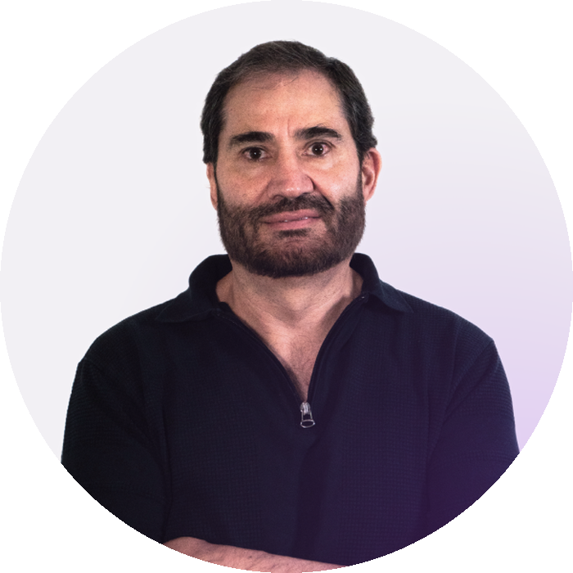

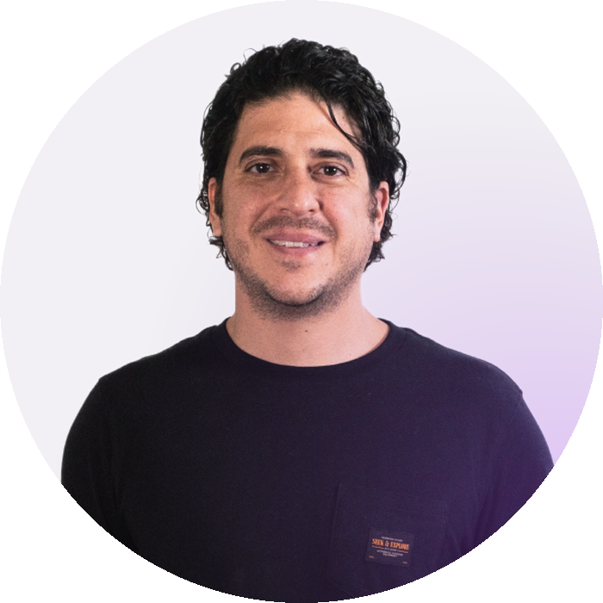
WHY UNGGA CAN WIN
Ungga is turning real-estate operating experience into productized intelligence.
VERTICAL OPERATING INTELLIGENCE
DURABLE OPERATION
COMPANY-SPECIFIC INTELLIGENCE
NETWORK & ECOSYSTEM
OUTCOME LOOP
workflows · exceptions · approvals · domain rules
state · dependencies · waits · verification
people · relationships · history · decisions · preferences
shared inventory · cross-brokerage opportunities · services
action → real-world result → future decision
COMPETITIVE DISTINCTION
FOUNDING TEAM
General-purpose AI agents
Foundation models
Broad execution across domains
Underlying intelligence
GU + GU OS
Real-estate operating environment
Alejandro
Mariana
Pablo
AI · systems · business
Real estate brokerage operations · sales · legal
PropTech · product · ecosystem
Better foundation models expand what Gu can do.
General-purpose agents raise the baseline for broad AI execution.
Ungga differentiates by embedding real-estate operating intelligence into durable, governed operations.
Notes:
We assume underlying AI increasingly commoditizes. Better foundation models should make Gu more capable and cheaper to operate. The assets we want to accumulate are vertical operating intelligence, durable operation, company-specific intelligence, network/ecosystem participation and the outcome loop. We do not claim an unassailable moat today. We are building assets that can compound as customers delegate more work to Gu.
--
Notas:
- Los cinco bloques son la defensibility thesis. No necesitamos volver a escribirla debajo como: Defensibility thesis:
accumulated vertical operating intelligence + company context + operational history + outcome evidence + network participation
- La distinción estratégica sobre los agentes IA generalistas (ej. OpenClaw, Hermes e incluso Claude Cowork) sería:
Un agente generalista puede potencialmente:
buscar una propiedad, llamar una API, redactar un contrato, revisar un calendario o ejecutar una secuencia.
Pero Gu OS busca aportar además:
real-estate domain state + workflows + company context + permissions + human decision points + evidence + operational history + outcomes + ecosystem/network.
Entonces no estamos apostando a que los agentes generalistas no puedan hacer las tareas.
Estamos apostando a que las inmobiliarias no querrán tener que construir y gobernar por sí mismas todo el operating environment necesario para convertir un agente generalista en un trabajador inmobiliario confiable y continuo.
Ungga’s differentiation is not the model or generic agent capability—it is the real-estate operating intelligence around the work.
- Por qué Broad cross-domain execution
Porque intenta describir qué ofrece un agente generalista como alternativa competitiva sin reducirlo a “chat” o “assistant”.
Un general-purpose agent puede: razonar sobre tareas muy distintas, usar herramientas, ejecutar acciones, coordinar pasos, trabajar en múltiples dominios.
Por eso Broad capability era correcto pero demasiado genérico. Broad cross-domain execution dice algo más concreto:
puede ejecutar trabajo en muchos dominios, no sólo entender o responder.
Y eso es precisamente la presión competitiva relevante para Ungga: un cliente sofisticado podría decir:
“¿Por qué no uso un agente generalista y lo conecto yo a mis sistemas?”
Ahora bien, no es una frase obligatoria. Si te parece demasiado técnica, una alternativa muy buena sería:
Broad AI execution across domains
que suena un poco más natural.
O incluso:
General-purpose execution
más corta, pero pierde algo de precisión.
Mi preferencia sigue siendo Broad cross-domain execution, pero no porque sea una verdad arquitectónica especial, sino porque explica bastante bien la alternativa competitiva.

Slide 13
Enabling the AI-native real-estate company
We envision real-estate companies becoming AI-native organizations in which humans lead and Gu gets an increasing share of the operational work done.
Humans lead. Gu gets work done.
HUMANS
THE RAISE
leadership · relationships · negotiation · judgment · accountability
Raising [US$ XX]
GU — AI COWORKER
understand · reason · communicate · act
[SAFE / Equity] · [XX-month runway]
GU OS — OPERATING INTELLIGENCE
Round designed to build and prove:
business context & relationships · durable work · workflows · coordination · governance · evidence
Repeatable product deployment
Productize Gu OS across customers
SYSTEMS · SERVICES · NETWORK
Repeatable commercial growth
Acquisition · paid usage · reload · retention
More output without operational headcount growing proportionally.
Expand work delegation
More high-value workflows executed by Gu
Extreme manifestation: “La Inmobiliaria de Uno” — a real estate entrepreneur backed by digital organizational capacity that historically required an entire team.
Notes:
We believe real-estate companies can operate very differently when humans no longer have to personally coordinate every piece of the operation. Humans continue to lead where relationships, judgment, negotiation and accountability matter. Gu can take on an increasing share of operational work, supported by Gu OS operating intelligence. At the extreme, one entrepreneur could have access to digital organizational capacity that historically required an entire team. For larger brokerages, the same principle means more output without coordination cost and operational headcount growing proportionally. This round is about turning the technical foundation into a repeatably deployable product, proving repeatable commercial growth, and expanding the amount of high-value work customers delegate to Gu.
---
Notes:
- Tres resultados:
Productize Gu OS for repeatable customer deployment Prove repeatable acquisition, reload & retention Expand the work customers can delegate to Gu
Esto comunica que hay tres máquinas que construir conjuntamente:
Product/deployment engine Gu OS debe poder desplegarse, configurarse y operar repetidamente en diferentes inmobiliarias, no sólo en el design partner/lab.
Commercial engine acquire → first work → pay → consume → reload → retain.
Value-expansion engine más workflows, más tipos de trabajo y más valor económico por cliente.
Y las tres requieren desarrollo tecnológico.
THIS ROUND IS DESIGNED TO BUILD & PROVE:
Y los tres bullets:
REPEATABLE PRODUCT DEPLOYMENT Productize and harden Gu OS for deployment across customers.
REPEATABLE COMMERCIAL GROWTH Acquire → paid usage → reload → retain.
EXPANDING WORK DELEGATION Extend Gu into additional high-value real-estate workflows.
No dices simplemente:
“Give us money to market what we've built.”
Dices:
“We have built the technical foundation. This capital turns it into a deployable product, proves its commercial engine, and expands the amount of economically valuable work it can take on.”
Eso describe mucho mejor la etapa real de Ungga.
Y además evita otro riesgo
No conviene que el Slide 11 diga:
Repeatable growth is the next proof
y este Slide 14 parezca decir:
therefore all the money is for growth.
Repeatable growth es el principal proof point empresarial, pero para conseguirlo tendremos que mejorar:
product onboarding;
Gu OS deployability/configuration;
workflows;
integrations;
reliability;
governance;
measurement;
customer experience;
first-work experience;
billing/credits;
and GTM.
Es decir, commercial proof is the outcome; product and engineering are a major part of how we get there.
Capital supports product & engineering, customer deployment, and GTM validation.

Slide 14



Thank you!
Contact
Alejandro Torres
Email
alex@ungga.com
Mobile
+52 55 4244 2888
Office
+52 33 3110 0083
Address
Av. Del Tule 839 L-11,
Col. Puertas del Tule,
45017 Zapopan, Jalisco,
Mexico
Website
ungga.com
Notes:
¡Muchas gracias!
Aquí les dejo mis datos. Será un gusto conversar más acerca de nuestra visión y cómo vamos a lograrla.

Slide 15
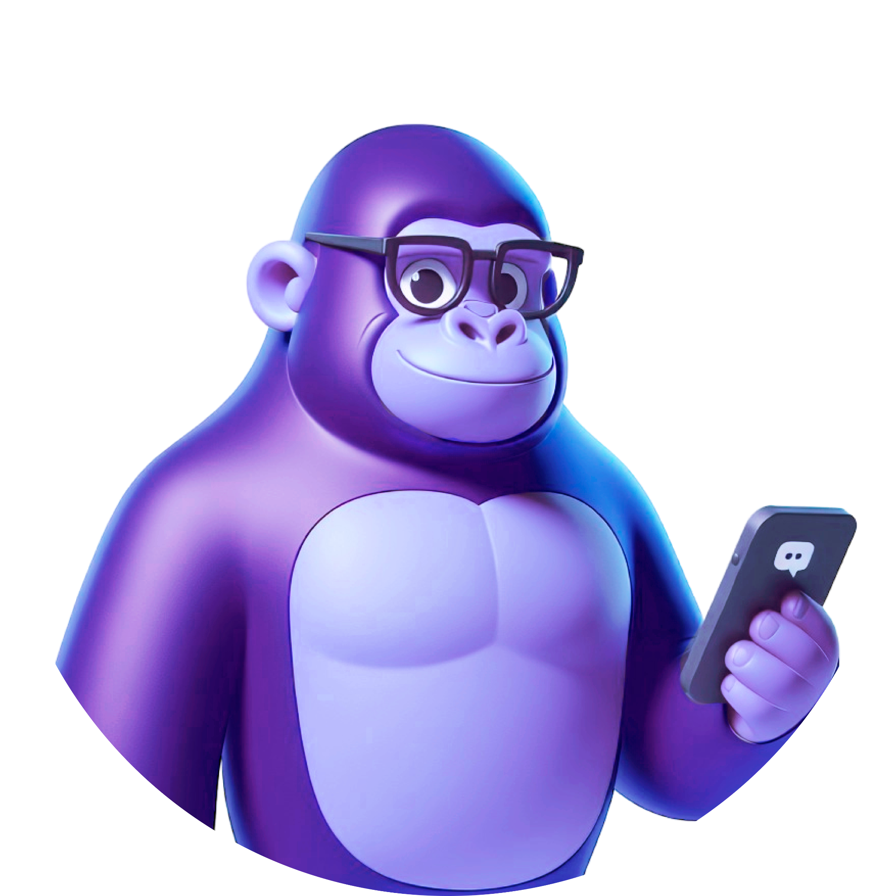
Appendix
Evidence, economics and product detail

Slide 16
COMPETITIVE LANDSCAPE
“AI Operating System” is a category — not a unique differentiator.
Ungga’s thesis is not simply better AI agents.
It is productized operating intelligence and execution across the real-estate operation.
STATUS QUO
VERTICAL SaaS + AI COPILOTS
GENERAL-PURPOSE AI AGENTS
VERTICAL AGENTIC PLATFORMS
UNGGA
Humans + fragmented tools
CRMs and other SaaS incumbents
Broad digital coworkers / agents
KOVA · Uniti · others
Gu + Gu OS
People still coordinate the operation manually.
Systems of record + workflows + growing AI assistance.
Powerful cross-domain reasoning and execution.
Real-estate-specific AI agents and workflows.
One Gu experience across workflows
+ durable operations
+ company-specific intelligence
+ outcome loop
+ shared inventory
+ integrated services ecosystem
Tradeoff: capacity and consistency depend on human attention.
Tradeoff: people still largely operate and coordinate the software.
Tradeoff: customers must assemble the real-estate operating & governance layer.
Closest category: battleground is cross-workflow operating intelligence & execution.
Software digitizes work → Copilots assist → Agents execute work → Gu OS aims to coordinate & execute work across the operation.
CONFIDENTIAL
ungga.com
16
Notes:
The important point in this slide is that calling ourselves an “AI Operating System” is not, by itself, a defensible differentiation. The category is clearly emerging. What matters is what kind of operating intelligence and execution we can productize and what work customers eventually trust us to own.
Today, our biggest immediate competitor is actually still the status quo. Real-estate companies already have people and software, but humans continue connecting the pieces: conversations, CRM, inventory, calendars, follow-up, decisions and external providers.
Traditional vertical SaaS and CRMs improve that significantly. They become systems of record and workflow systems, and increasingly add AI copilots. But the basic interaction model still tends to be that people operate the software and coordinate much of the work.
General-purpose AI agents move one step further. They can reason, use tools and execute increasingly sophisticated work across many domains. We assume that capability will continue improving. The challenge for a brokerage is that using a generic agent for serious operations still requires assembling and governing the real-estate operating layer around it — the domain context, workflows, integrations, permissions, business state and verification.
The closest competitive category for us is vertical agentic platforms. We do not assume that having agents is itself a differentiator. We think the real battleground will be who builds the strongest cross-workflow operating intelligence and execution layer for the industry.
KOVA is particularly relevant because it overlaps directly with our Mexican brokerage market. Its public positioning is “the operating system with AI for real-estate companies,” and it already combines CRM functionality, WhatsApp operation and AI automation. Publicly, however, the product still appears relatively hybrid: there are important traditional software surfaces and workflows that users operate, alongside AI that recommends and automates parts of the work. For example, KOVA presents both automatic WhatsApp operation and more conventional pipeline/CRM patterns. So our differentiation is not that KOVA “doesn't have AI”; it clearly does. Our direction is more explicitly toward delegating end-to-end work to Gu rather than having the user remain the primary operator of the software.
Uniti is a different and, in some ways, more agent-first benchmark. It publicly offers specialized agents across Sales & Leasing, Support, Maintenance, Collections, Reviews, Renewals, Data Analysis and Payments, operating across voice, SMS/WhatsApp, email and web chat and integrating into the PMS/CRM systems its customers already use. So it would be inaccurate to describe Uniti as simply a collection of disconnected bots — it clearly invests in shared infrastructure, context and workflow execution.
There is also an important market distinction. Uniti publicly targets real-estate operators rather than traditional brokerage firms, with dedicated offerings for Self Storage, Office & Flexible Workspace, Multifamily / Student Housing, Senior Living and Manufactured Housing. Its examples and workflows revolve around things such as move-ins, tenant support, collections, maintenance, renewals and payments. That makes it a highly relevant agentic benchmark, but not a perfect overlap with our initial market: real-estate brokerages in Mexico and LatAm, where the operating loop is more centered on property onboarding, demand generation, matching, visits, brokerage relationships and transactions.
I would not characterize Uniti as exclusively U.S.-only. Its public positioning and many of its use cases are strongly oriented toward the kinds of real-estate operators common in North America, but its partner ecosystem also shows international coverage, including an APAC / UK self-storage integration. So the stronger distinction for us is not simply geography — it is customer type, operating model and product philosophy.
The product philosophy is nevertheless different. Uniti exposes specialization largely through functional agents.
Our bet is one Gu experience across workflows: the user works with Gu around the business objective, while specialization can remain underneath in Skills, tools, workflows and specialized capabilities. In simple terms: specialized-agent architectures tend to map AI to functions; we want Gu OS to organize AI around objectives and end-to-end work.
That does not mean Uniti's approach is inferior. Specialized agents have real advantages: they can be easier to understand, package, measure, permission and optimize. Our hypothesis is that one Gu experience can reduce cognitive overhead and make cross-functional workflows more natural, provided Gu OS handles the complexity underneath.
There are also some assets already in place. Shared inventory is one example: Gu can mobilize inventory across participating brokerages rather than being limited to one company's listings. We also already have real brokerage context, integrations and the durable-work foundation of Gu OS. Other elements on this column — especially deeper company-specific intelligence and the outcome loop — are things we expect to compound as more real work runs through Gu.
So the takeaway is not “everyone else is traditional and Ungga has AI.” That would be wrong. The competitive evolution is from software that digitizes work, to copilots that assist it, to agents that execute it. Our ambition with Gu OS is to coordinate and execute work across the real-estate operation — through one Gu experience, increasingly informed by company context, outcomes and the broader real-estate network.
---
Notas adicionales:
- La slide cuenta una progresión bastante sofisticada:
Status quo
Humans coordinate everything.
Traditional vertical software + AI copilots
Software organizes work and AI helps.
General agents
AI can execute, but customer must assemble the vertical operating layer.
Vertical agentic platforms
Vertical execution already exists; this is the closest competitive battleground.
Ungga
One Gu experience over durable, company-specific, connected operating intelligence.
Eso es mucho mejor que una tabla típica de:
✅ nosotros ❌ todos los demás.
---
Después de revisar nuevamente la información pública actual de KOVA y Uniti, creo que tu lectura va en una dirección correcta, pero hay que afinarla porque las dos empresas son bastante distintas entre sí. Y esto también me hace cambiar cómo describiría nuestro “CURRENT EDGE”.
0) No llamaría a durable operation foundation y brokerage-specific context ventajas competitivas demostradas todavía
Durable operation foundation sí es un activo real de Ungga, pero no podemos afirmar hoy que sea una ventaja diferenciadora frente a todos los vertical-agentic competitors. Uniti, por ejemplo, habla públicamente de un Agent Operating System, continuidad de contexto entre canales, integración con PMS/CRM y agentes que observan continuamente el sistema y ejecutan workflows. Eso sugiere que también han resuelto al menos una parte importante del problema de continuidad/durabilidad operacional.
Con KOVA es menos claro arquitectónicamente, pero tampoco podemos asumir que sólo tiene un chatbot: públicamente afirma que responde leads automáticamente por WhatsApp y mueve el pipeline basándose en respuestas y acciones del prospecto.
Entonces yo distinguiría:
CURRENT ASSETS ≠ PROVEN COMPETITIVE EDGE
Gu OS durable work es un current asset. Puede convertirse en edge si demostramos que nos permite cubrir operaciones más complejas/mejor que ellos, pero no sabemos que ellos carezcan de algo equivalente.
Con brokerage-specific context pasa algo parecido. Gu sí tiene hoy contexto real de propiedades, leads, conversaciones, appointments, etc. Pero la noción amplia de company-specific operating intelligence / Business Brain todavía está en formación. No la vendería como moat actual.
En cambio, Shared Inventory sí me parece un current differentiator bastante más concreto, especialmente en México. En la revisión de los productos públicos de KOVA y Uniti no encontré una capacidad equivalente de red entre inmobiliarias que permita a una inmobiliaria movilizar inventario de otras y generar oportunidades cruzadas. Eso no prueba que no exista internamente, pero no es una capability que estén presentando públicamente como parte de su producto. KOVA enfatiza CRM/pipeline/operación/IA y Uniti integración con PMS/CRM y agentes funcionales.
1) KOVA: sí veo el patrón que estás detectando, pero no lo llamaría simplemente “not AI-first”
Aquí hay un matiz muy importante.
La página pública de KOVA efectivamente mantiene muchas metáforas de software que el humano opera: pipeline con etapas Prospecto → Cita → Negociación → Documentación → Cierre, repositorio documental, pasos sugeridos por etapa y el mensaje:
“KOVA te dice a quién darle seguimiento hoy.”
Todo eso tiene bastante sabor de vertical SaaS/CRM evolucionado con IA.
Y coincido contigo en tu interpretación de esa frase. Si el sistema:
“te dice a quién darle seguimiento”
pero el trabajo operativo siguiente sigue dependiendo de que el asesor vea la lista, priorice y haga el seguimiento, estamos mucho más cerca de:
AI recommends → human operates
que de nuestra tesis:
AI understands → decides within policy → executes → human intervenes when judgment/authority is actually required.
Eso sería una diferencia importante.
Pero no debemos llevar esa interpretación demasiado lejos, porque KOVA también publica capacidades bastante más autónomas. Por ejemplo, afirma que puede responder leads automáticamente por WhatsApp con lenguaje natural y mover el pipeline según las respuestas/acciones del prospecto.
Por tanto, yo describiría a KOVA así:
KOVA appears publicly as a hybrid: vertical CRM/operating software with meaningful AI automation and agentic capabilities, but with significant parts of the operating model still exposed as software the user operates.
No afirmaría:
“KOVA is not AI-first.”
porque no conocemos suficientemente su arquitectura interna y ellos mismos hablan de IA agéntica.
Pero sí podemos decir:
Their public UX and positioning appear more hybrid between traditional vertical software and agentic operation than Ungga’s intended “delegate the work, don’t operate the software” model.
Y eso me parece una diferenciación mucho más defendible.
2) Uniti es un competidor conceptualmente distinto —y probablemente más “agent-first”
Uniti es mucho más explícitamente agentic. Se define como “The Agentic AI Platform for Real Estate Operators” y ofrece agentes especializados para Sales & Leasing, Support & Service, Maintenance, Collections, Customer Reviews, Renewals, Data Analysis y Payments. Además opera por Voice, SMS/WhatsApp, Email y Web Chat, dentro de los PMS/CRM existentes.
Y no son simplemente agentes que aconsejan. Por ejemplo, su Renewal Agent dice que observa continuamente el PMS y detecta leases próximos a renewal; otras páginas describen resolución automática de llamadas, pagos, maintenance, etc.
Por eso yo diría que Uniti está más cerca de nuestra filosofía de AI doing the work que KOVA, al menos por lo que muestran públicamente.
Pero tiene dos diferencias estratégicas grandes respecto a Ungga.
Primero, su mercado público está muy orientado a real-estate operators: self-storage, multifamily/student housing, senior living, manufactured housing, office/flex workspace, etc.; no principalmente al brokerage residencial mexicano que constituye nuestro wedge.
Segundo, su arquitectura/product packaging es explícitamente de múltiples agentes especializados.
Y aquí vuelvo a la diferencia que habíamos identificado:
Uniti: specialized agents exposed as a team + shared agent operating system. Ungga: one Gu coworker experience + many Skills/tools/workflows/specialized capabilities behind Gu OS.
Eso no significa que el enfoque de Uniti sea inferior. Tiene ventajas claras: cada agente es fácil de entender, comprar, medir y optimizar; los boundaries de Sales, Collections, Maintenance, Renewals, etc. pueden ser muy claros. Uniti además tiene una capa de operating system y continuidad entre canales, precisamente para mitigar el problema de fragmentación entre agentes.
El tradeoff potencial es que cuando el trabajo atraviesa funciones, alguien —el sistema— debe resolver ownership, handoffs, contexto global y coordinación entre agentes. Nuestra apuesta es diferente:
One front door. Many capabilities underneath.
El usuario trabaja con Gu, no tiene que decidir si necesita “el Collections Agent”, “el Listing Agent”, “el Marketing Agent” o “el Contracts Agent”. Gu OS debería determinar cómo movilizar las capacidades adecuadas.
Eso puede reducir cognitive overhead y favorecer continuidad cross-workflow, pero todavía es una thesis que tenemos que demostrar, no una superioridad comprobada.
Entonces cambiaría cómo pensamos la columna de Ungga en esa slide
En vez de CURRENT EDGE, usaría algo más intelectualmente honesto como:
CURRENT ASSETS
Existing Gu lead-conversion worker with real brokerage usage Shared inventory + cross-brokerage opportunity mechanism Local CRM / real-estate service integrations Gu OS durable-work foundation Mexico brokerage operating experience
Y luego:
DIFFERENTIATION WE ARE BUILDING
One Gu experience across workflows Company-specific operating intelligence Outcome-connected decision making Compounding network / ecosystem
Esto me gusta bastante más que etiquetar todo como “edge”. Algunos son ya activos reales; lo que todavía falta demostrar es cuánto se convierten en una ventaja competitiva.
Y en VERTICAL AGENTIC PLATFORMS incluso distinguiría internamente a los dos:
KOVA — Mexico brokerage OS; hybrid vertical software + AI automation Uniti — AI-first multi-agent platform for real-estate operators
La conclusión sería:
Closest battleground: who becomes the operating intelligence layer across the real-estate company—not simply who ships the most AI agents.
Creo que esta versión captura mucho mejor la realidad competitiva:
KOVA es probablemente el overlap local más directo;
Uniti es probablemente el benchmark agentic más sofisticado, pero en segmentos distintos; y Shared Inventory + la apuesta “one Gu + Gu OS” son dos áreas donde sí tenemos una historia particularmente propia.
--
El modelo de “muchos agentes especializados” puede reflejar y reforzar la estructura funcional tradicional de una organización, aunque no necesariamente obliga técnicamente a operar en silos.
Uniti, por ejemplo, empaqueta públicamente agentes como Sales & Leasing, Support & Service, Maintenance, Collections, Renewals, Payments, etc. Eso hace que cada agente sea fácil de entender, comprar y medir. Al mismo tiempo, Uniti dice tener un Agent Operating System compartido, continuidad entre canales e integraciones con PMS/CRM, así que no sería correcto concluir que sus agentes están técnicamente aislados.
Pero tu intuición estratégica sí es interesante.
Dos paradigmas distintos
El enfoque de múltiples agentes tiende naturalmente a pensar:
What function or role owns this work?
Sales Agent → Collections Agent → Maintenance Agent → Renewal Agent
Es parecido a traducir el organigrama humano a una organización digital de agentes especializados.
Eso tiene ventajas reales: ownership claro, KPIs claros, permisos más fáciles de acotar, packaging comercial sencillo.
Pero potencialmente puede traer consigo el mismo problema conceptual de una organización funcional:
el valor real para el cliente rara vez cabe perfectamente dentro de una sola función.
Un proceso puede atravesar:
lead → matching → visit → negotiation → documents → financing → closing → follow-up
sin que al cliente le importe demasiado qué “departamento digital” está ejecutando cada paso.
La apuesta de Gu puede ser diferente
Nuestra filosofía puede partir de:
What outcome or business case are we trying to advance?
y no de:
Which agent owns this function?
Entonces Gu recibe el objetivo:
“Move this buyer toward the right property and a visit.”
o:
“Get this property captured, approved and published.”
Y Gu OS determina qué combinación de workflows, Skills, tools, deterministic services, specialized workers and humans necesita.
Por eso una frase que me parece particularmente potente es:
Many specialized agents map AI to functions. One Gu can map AI to business objectives and workflows.
No significa que Gu OS no pueda tener especialización interna. Todo lo contrario.
Debajo de Gu podría haber:
workers especializados;
Skills especializados;
herramientas de valuación;
campaign capabilities;
document processing;
scheduling;
etc.
Pero el usuario no tiene que organizar mentalmente ese workforce.
Eso es el principio:
One front door. Many capabilities underneath.
Y sí: ahí One Gu experience puede ser una ventaja importante
No solamente por simplicidad de UX.
Tiene potencialmente cuatro ventajas más profundas:
1. Lower cognitive overhead El usuario no tiene que decidir qué bot/agente usar.
2. Cross-workflow continuity Gu puede continuar un mismo business case cuando cambia la naturaleza del trabajo.
3. Objective-first orchestration La unidad organizadora puede ser el objetivo/case, no el departamento.
4. Company-level context El mismo coworker puede interpretar información proveniente de distintas partes de la empresa dentro de un contexto común.
Eso se acerca bastante más a nuestra idea de AI-native organization que simplemente digitalizar el organigrama humano con agentes.
Pero no vendería “one agent” como intrínsecamente superior
También tiene riesgos.
Un único Gu tiene que evitar convertirse en:
“un superagente genérico que intenta hacer todo”.
Para que funcione, Gu OS necesita resolver muy bien:
routing;
permissions;
specialization;
durable cases;
tool selection;
human authority;
verification.
Es decir, la simplicidad externa exige sofisticación interna.
Y ésa puede convertirse precisamente en parte del valor de Gu OS.
Creo que encontramos una distinción competitiva bastante buena
Podríamos expresarla así:
Specialized-agent model
Organize AI around functions.
Gu / Gu OS
Organize AI around business objectives and end-to-end work.
O todavía más provocador:
Others may digitize the org chart with AI agents. Gu OS aims to organize AI around the work itself.
Esta última me gusta mucho conceptualmente, aunque yo la usaría con cuidado porque no debemos afirmar que Uniti sólo replica el organigrama; eso sería una inferencia excesiva a partir de su packaging público. Uniti sí muestra coordinación e infraestructura compartida entre sus agentes.
Pero como filosofía de producto de Ungga, me parece una idea muy poderosa:
Not a collection of digital departments. One AI coworker that can coordinate work across the company.
Y sí: creo que eso conecta de forma muy natural One Gu experience + dynamic workflows + durable cases + Gu OS + Business Brain en una sola tesis.

Slide 17
APPENDIX · CLOSED-LOOP ECONOMICS
Optimizing for leads can be very different from optimizing for business outcomes.
Illustrative example — not customer data.
CAMPAIGN A
CAMPAIGN B
Cost / lead
MXN $70
Cost / lead
MXN $130
Leads
100
Leads
100
Visit rate
2%
Visit rate
14%
Cost / visit
MXN $3,500
Cost / visit
≈ MXN $929
Which campaign is actually better?
Lower CPL does not necessarily mean a better downstream business outcome.

Slide 18
APPENDIX · MARKET EVIDENCE
Market sizing will be built bottom-up from target organizations × realistic annual Gu spend.
Broad market references help frame the opportunity, but they are not automatically Ungga’s TAM.
8,243
7,079
15,000+
MXN 2.2K+
Economic units in Mexico: “Inmobiliarias y corredores de bienes raíces” (broad DENUE reference).
of those economic units have 0–10 employees — evidence of an SMB-skewed market.
agents served, company-reported by EasyBroker — an adoption proxy, not market size.
monthly public portal-spend example (Inmuebles24 5-listing Simple plan, +VAT).
Sizing method
×
Realistic annual Gu spend
by segment
=
[$XX]
Target brokerages
Bottom-up SAM
Then separate: what customers spend today · what Gu can economically influence · what Ungga can realistically capture.

Slide 19
APPENDIX · PRODUCT ARCHITECTURE
Gu OS: durable intelligence between the coworker and the real world.
GU — AI COWORKER
understand · reason · communicate · act
OPERATING INTELLIGENCE
business context & relationships · durable state · cases · workflows
SKILLS & TOOLS
reusable procedures · APIs · CRMs · calendars · valuations · external services
GOVERNANCE & VERIFICATION
permissions · human decisions · evidence · acceptance criteria · changed-fact repair
REAL WORLD
people · inventory · CRM · calendars · documents · service providers

